Slide 1


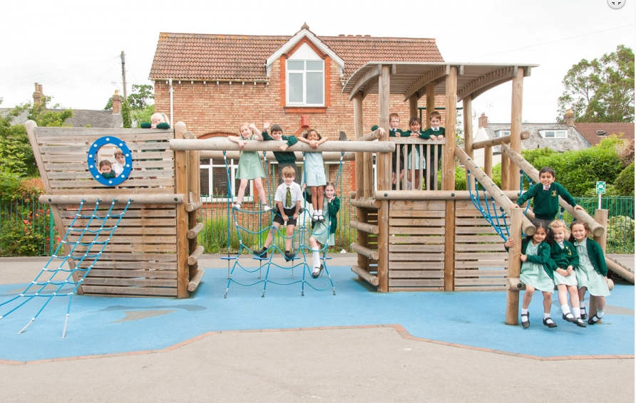
SEND Information Report
Date October 2025

Slide 2
This report is designed to inform you of the types of support available for your child at North Town Primary School and Nursery.
It will help you understand who can help and how this help can be accessed.
This report has been co-produced with staff, parents, carers, students and governors

Slide 3

Definition of Special Educational Needs
(taken from SEND Code of Practice: 0 to 25 years –
January 2015)
A pupil has SEN if they have a learning difficulty or disability which calls for special educational provision to be made for them. Namely provision that is different from or additional to that normally available to pupils of the same age. Making higher quality teaching normally available to the whole class is likely to mean that fewer pupils will require such support. (6.15 pg 94)

Slide 4
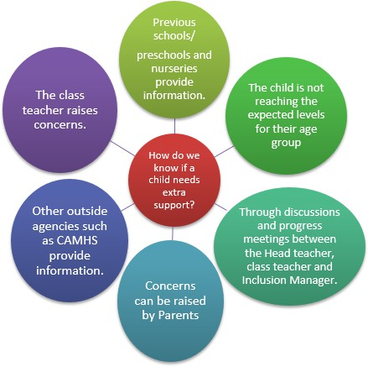
How does the school know if a child needs extra help?
All children at North Town Primary School and nursery are monitored closely by their class teachers and key workers. This is done through regular observation and assessment. Information can also come from previous settings, parents and/or external agencies. We use this information to identify and support children’s needs. Initially, it is the responsibility of the class teacher to ensure needs are being met within the classroom or nursery setting. If the class teacher or key worker feels the child still isn’t making the required progress, they will discuss this with you and then with the Special Education Needs and Disabilities Co-ordinator (SENDCo) if needed. Assessments may be carried out and, if necessary, additional interventions may be put in place and/or a referral could made to external agencies with your consent.

Slide 5
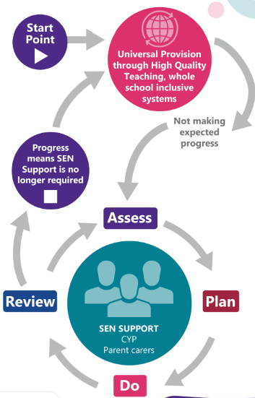
How will the school support my child?
The class teacher or key worker at nursery is responsible for your child’s education. They will plan and provide more individualised work for your child if needed or adapt class tasks to enable your child to access the learning. All teachers follow the same process for children who need some extra support which looks like this:

Slide 6

How will the School Support my Child and how much support is needed?
The school follows a ‘Graduated Response’ to identifying student’s needs and how much support is required. Somerset’s Graduated Response Tool. This begins with an identified need/concern that can be met with provision that is available to all students (universal provision). This is overseen by Class Teacher and SENDCo. Progress is then monitored through an ‘Assess, Plan, Do, Review’ process that measures the impact of any intervention/strategy and plans appropriate future support. If support which is additional to and different from their peers is required, this sits within the school’s ‘SEND Support’ stage. If a child has complex/acute needs, this sits within the school’s ‘High Needs’ stage and usually means that a student requires an Education, Health and Care Plan to support their needs and identify specific provision.

Slide 7

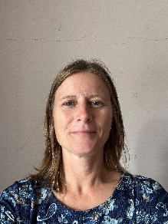
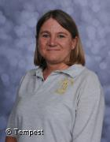
Who will coordinate the provision for my child?
Our SENDCOs coordinate the support and progress of any child on our SEN support list. You should know if your child is on this list and it simply means that Becca Hampshire, Tracey Burke or Christine Tohall, our SENDCos are overseeing their learning. Any additional provision/support that your child is receiving will be explained to you at parent’s evening.
Becca Hampshire School SENDCO Years 2 to 6
Tracey Burke School SENDCO Years R and 1
Christine Tohall Nursery SENDCO

Slide 8
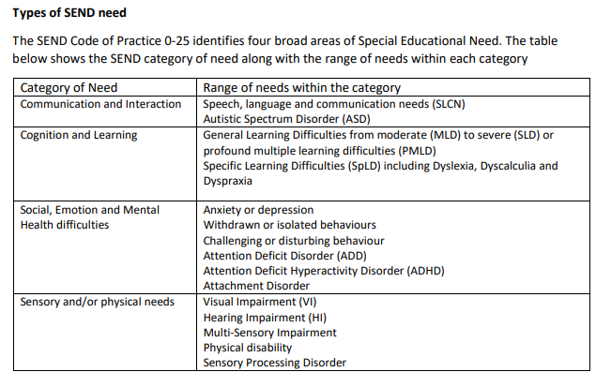
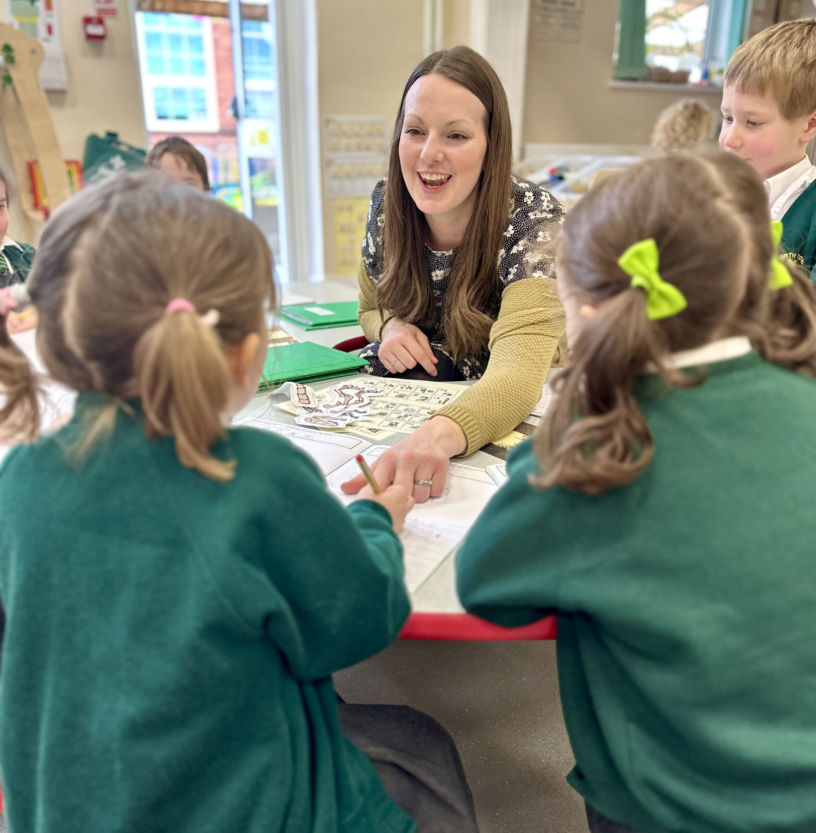
What kinds of SEND are provided for at North Town?
Attention Deficit Hyperactivity Disorder (ADHD) Attachment Difficulties
Self injury
Oppositional Defiance Disorder (ODD) Mental illness – depression/anxiety

Slide 9
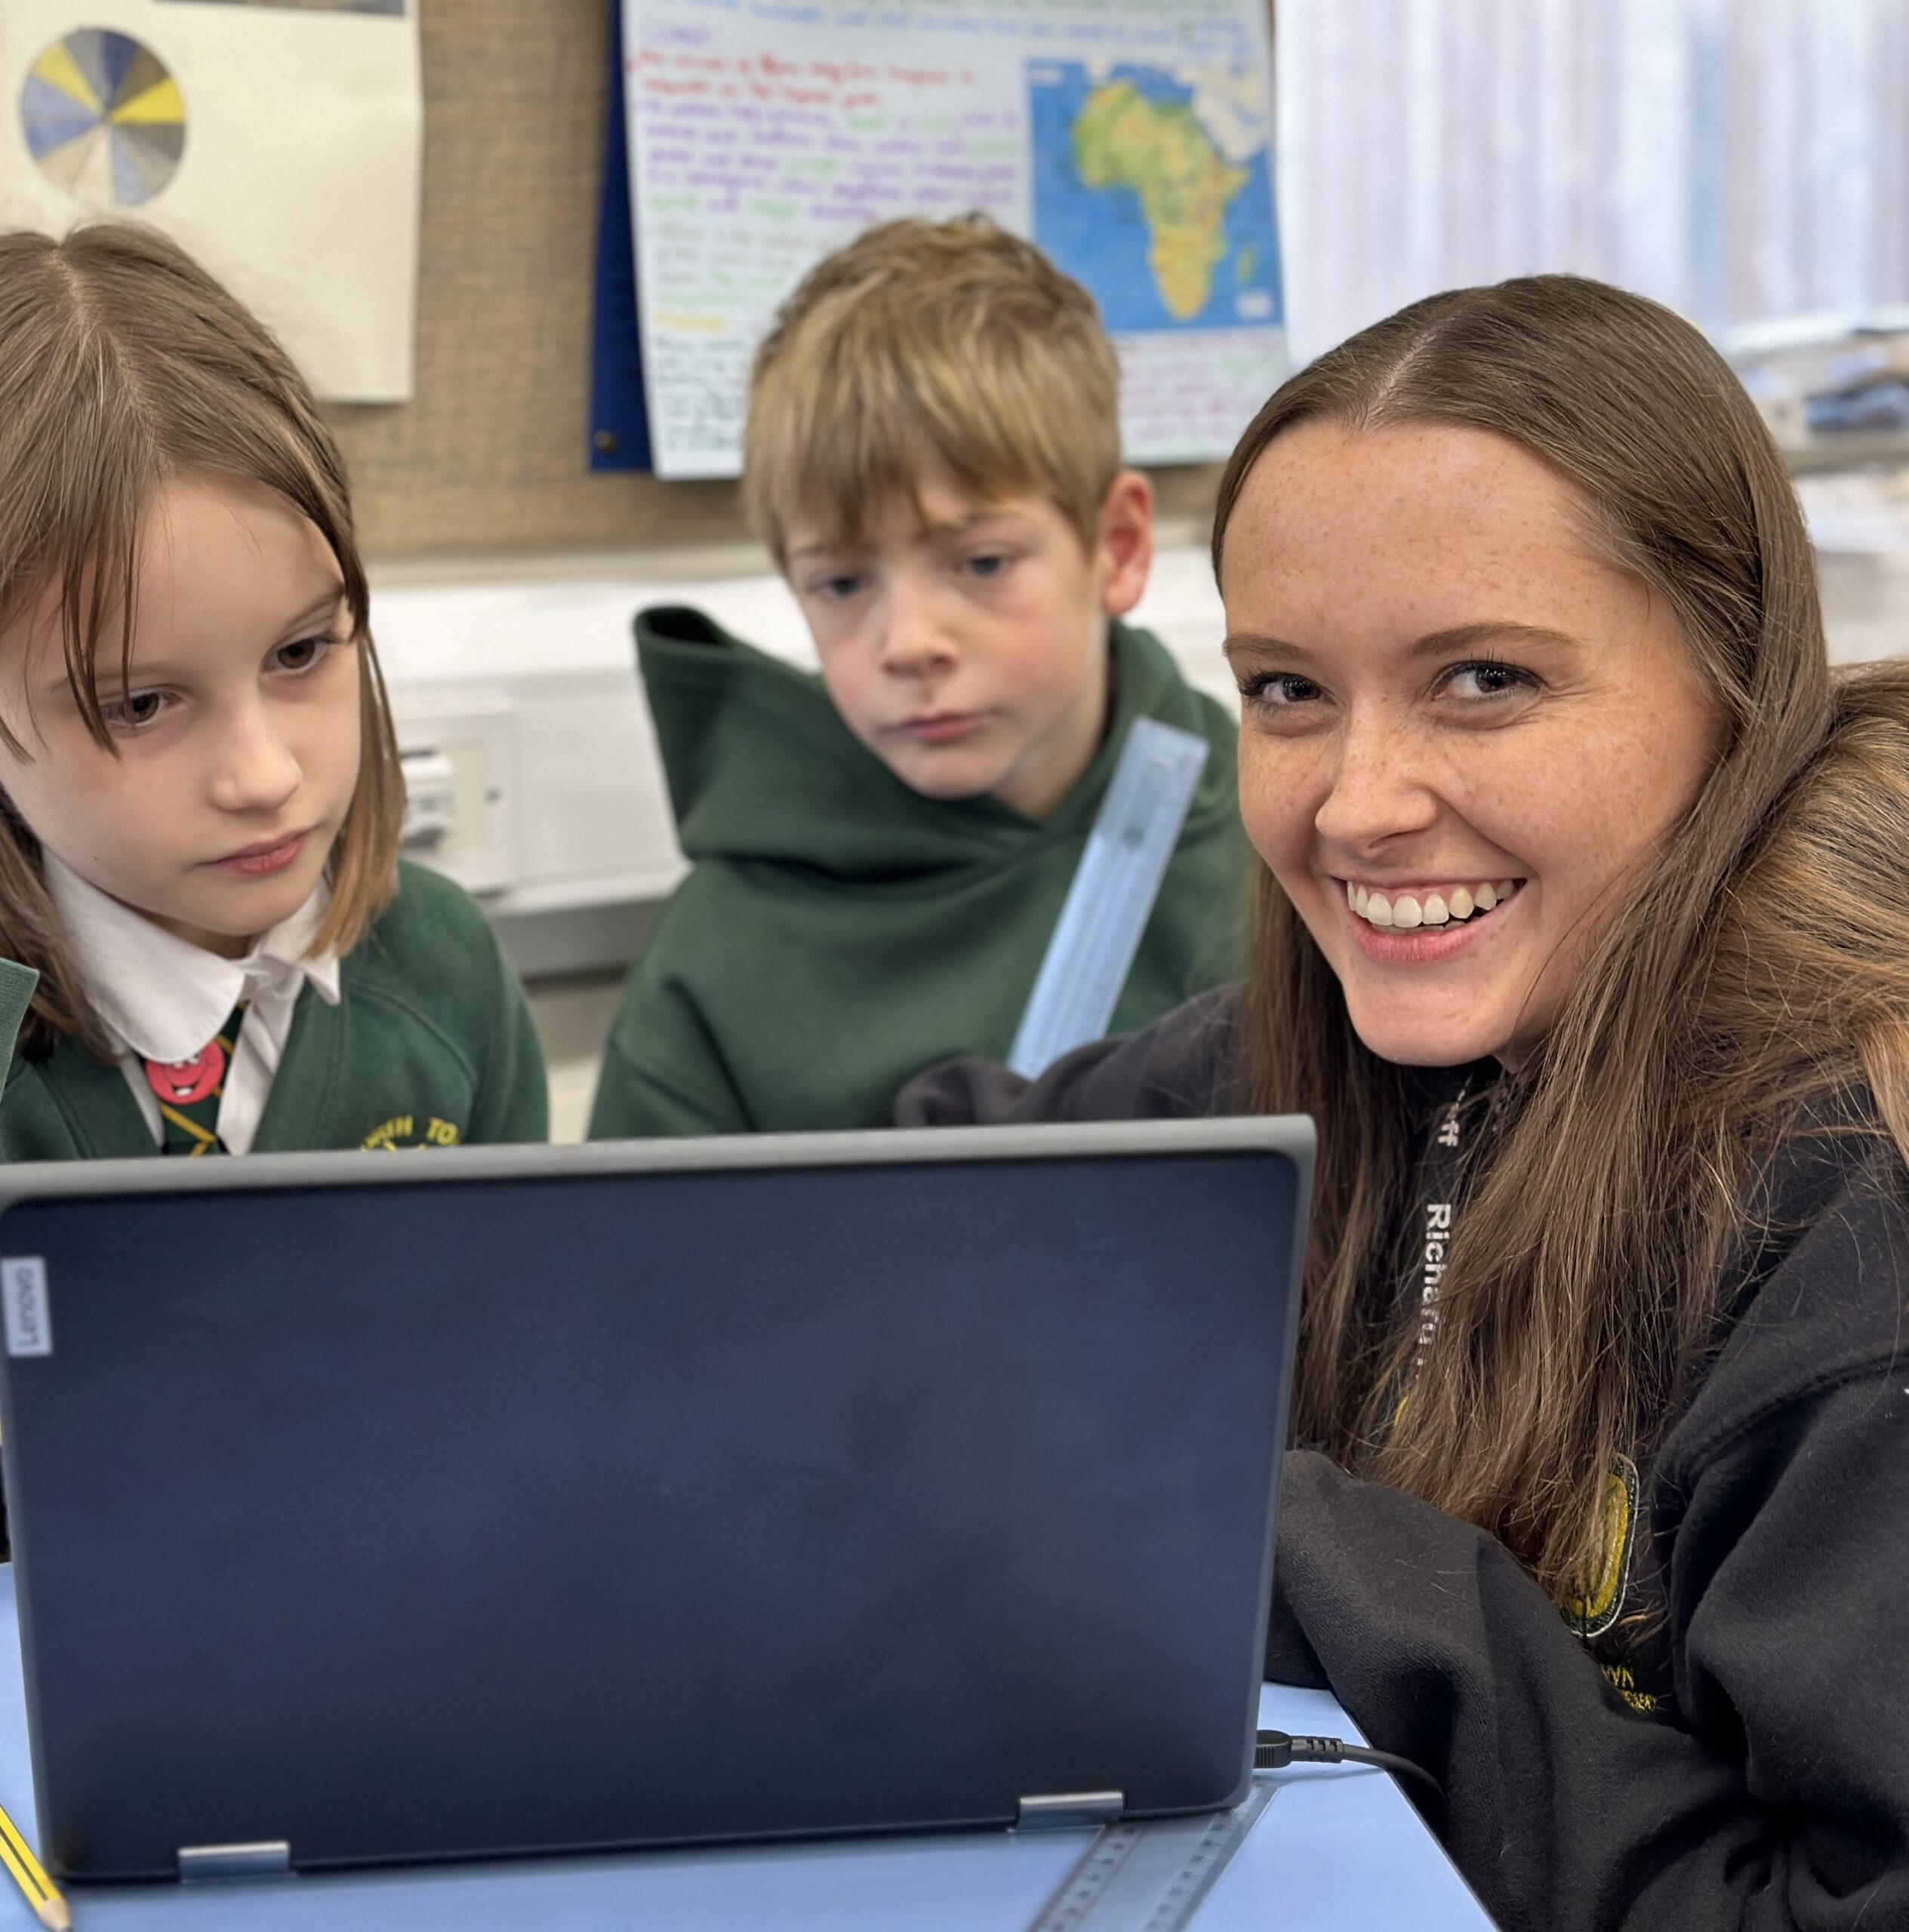
How will the school’s approach be adapted to match my child’sneeds?
As a school we are committed to providing high quality teaching. Most children will follow the same curriculum as their peers, with teachers altering the lesson content to take account of learning needs. Observation, marking and assessment inform teachers’ planning to ensure all work is accurately pitched at an appropriate level. Typically, this might mean that a child would receive additional support to help them access a lesson (this could be scaffolding through questions or additional resources) or there would be different levels of work set for the class.

Slide 10
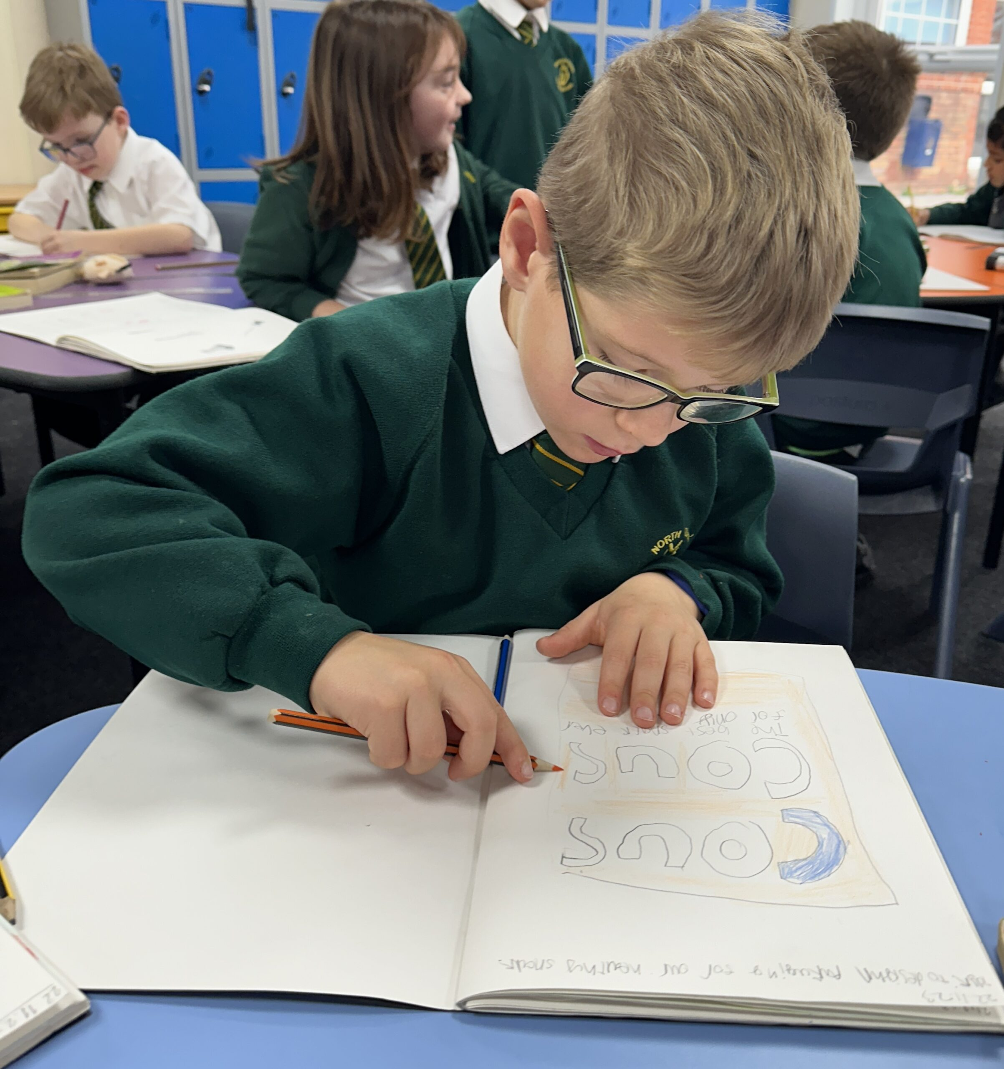
How will I know how my child is doing?
The school uses termly assessments to track each child’s progress. Additional provision is also tracked and monitored for impact. There are parents’ meetings in the Autumn, Spring and Summer terms for children who have SEND provision. End of year reports are sent home in the Summer term. Any child with complex needs or in receipt of an Education, Health and Care plans (somerset.gov.uk) will also have an Annual Review meeting to inform and plan for next steps. These meetings will provide you with the opportunity to discuss your child’s pupil passport, the support they have had that term and their progress.
In addition every child receiving SEND provision will also have an individual plan, known as an Individual APDR (Assess, Plan, Do Review). These will be written and sent home at the beginning of each term, discussed at the termly meetings and sent home at the end of a term with a final review. Parent comments on the individual APDR are always encouraged and welcomed.

Slide 11


What support will there be for my
child’s overall wellbeing?
North Town school is committed to the wellbeing of your child. Their first point of contact will be with their class teacher. There are a variety of lunch time and after school clubs available to support your child’s social and personal development. Our PSHE curriculum is taught weekly and provides children with opportunities to discuss and identify how to look after and develop their own wellbeing. THRIVE is also used to support wellbeing across the school in all classes and THRIVE practitioners work with children either individually or within a small group to support them with any social, emotional, mental health needs.
Gillian Ford THRIVE Lead Practitioner
Bex Howell THRIVE Practitioner

Slide 12


What specialist services are available to support my child?
The staff team, has considerable experience supporting children with dyslexia, autistic spectrum condition, ADHD, social and emotional difficulties, speech and language difficulties, general learning difficulties and physical/sensory needs.
When needed we can seek advice from services such as:
Children and Young People’s Therapy Service (including Speech & Language Therapists,
Occupational Therapists, etc)
Local Authority Advisory Teachers from Access to Inclusion, Ethnic Minority Achievement Service (EMAS)
Taunton Deane Partnership College - outreach service for SEMH needs (Social, Emotional and Mental Health)
Educational Psychology Service (EPS) (this is a service we have to buy into so hours are
limited)
Child and Adolescent Mental Health Service (CAMHS)
Education Safeguarding Service (ESS)
We also have a Speech and Language Therapist who works in school for one day every other week.
Claire Morris (speech and language therapist)

Slide 13
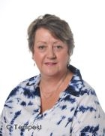

What support does North Town have for a parents including parents of children with SEND?
Your child’s class teacher and SENDCo will be happy to offer any support they can.
We can also refer families for support from a Parent and Family Support Advisor (PFSA) who can work with children and families in a variety of different ways.
This can include:
Parenting
Finances
Housing
Links between home and school
Our PFSA also runs ‘Emotional Coaching’ courses every term for 6 weeks available to all parents.
We can also signpost and/or refer you to other specialist support services…
Elaine Duley (PFSA)
Home (somersetsend.org.uk) SENDIAS
Somerset’s SEND Local Offer The SEND Local Offer
Family Intervention Service (somerset.gov.uk) FIS

Slide 14

Is there anyone else who might work with my child?
A range of outside professionals may be consulted to provide support or advice to help us to meet your child’s needs.
For further information on the services available, please look at the Somerset Local Offer website: Somerset’s SEND Local Offer

Slide 15
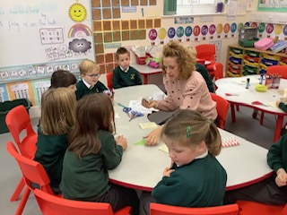
What training is made available to staff supporting children with SEND?
All staff have regular training opportunities to support the children at North Town including those with SEND. The focus of training is regularly reviewed according to the needs of the children and the school’s priorities for improvement.
All adults who work with individuals or groups of children receive the necessary support or training to deliver the sessions. These sessions are overseen by the class teacher and the SENDCo to monitor the progress of the children. The extent and level of training/support provided depends on the nature of a child’s needs and the provision needed.

Slide 16
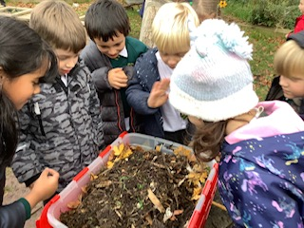
How are resources allocated and matched to my child’s needs?
We ensure that all children who have additional needs are supported to the best of the school’s ability with the funds available. We firmly believe at North Town that all teachers are teachers of all the children in their class and where possible additional provision will be delivered by the teacher through differentiated learning opportunities within the classroom. We also have a team of Learning Support Assistants (LSAs) who are in part funded from the SEN budget and support both individual and small groups of children, alongside the class teachers. Some children also need specialist equipment and/or facilities. A small number of children are eligible for top up funding which the school can use to provide additional support/resources within the child’s setting.

Slide 17
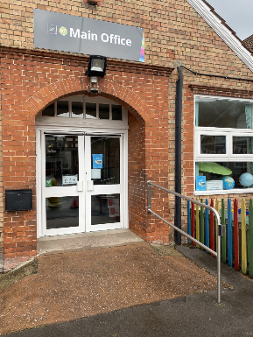

How accessible is the schoolenvironment?
The school site is wheelchair accessible and there are changing facilities and accessible toilets. All children have the right to access class wherever it is safe for them to do so. For those children with additional needs, alternative provision can be made, for example, additional adult support, alternative travel arrangements, or alternative arrangements for the administration of medicines. For further information on accessibility please see our separate Accessibility Plan.

Slide 18
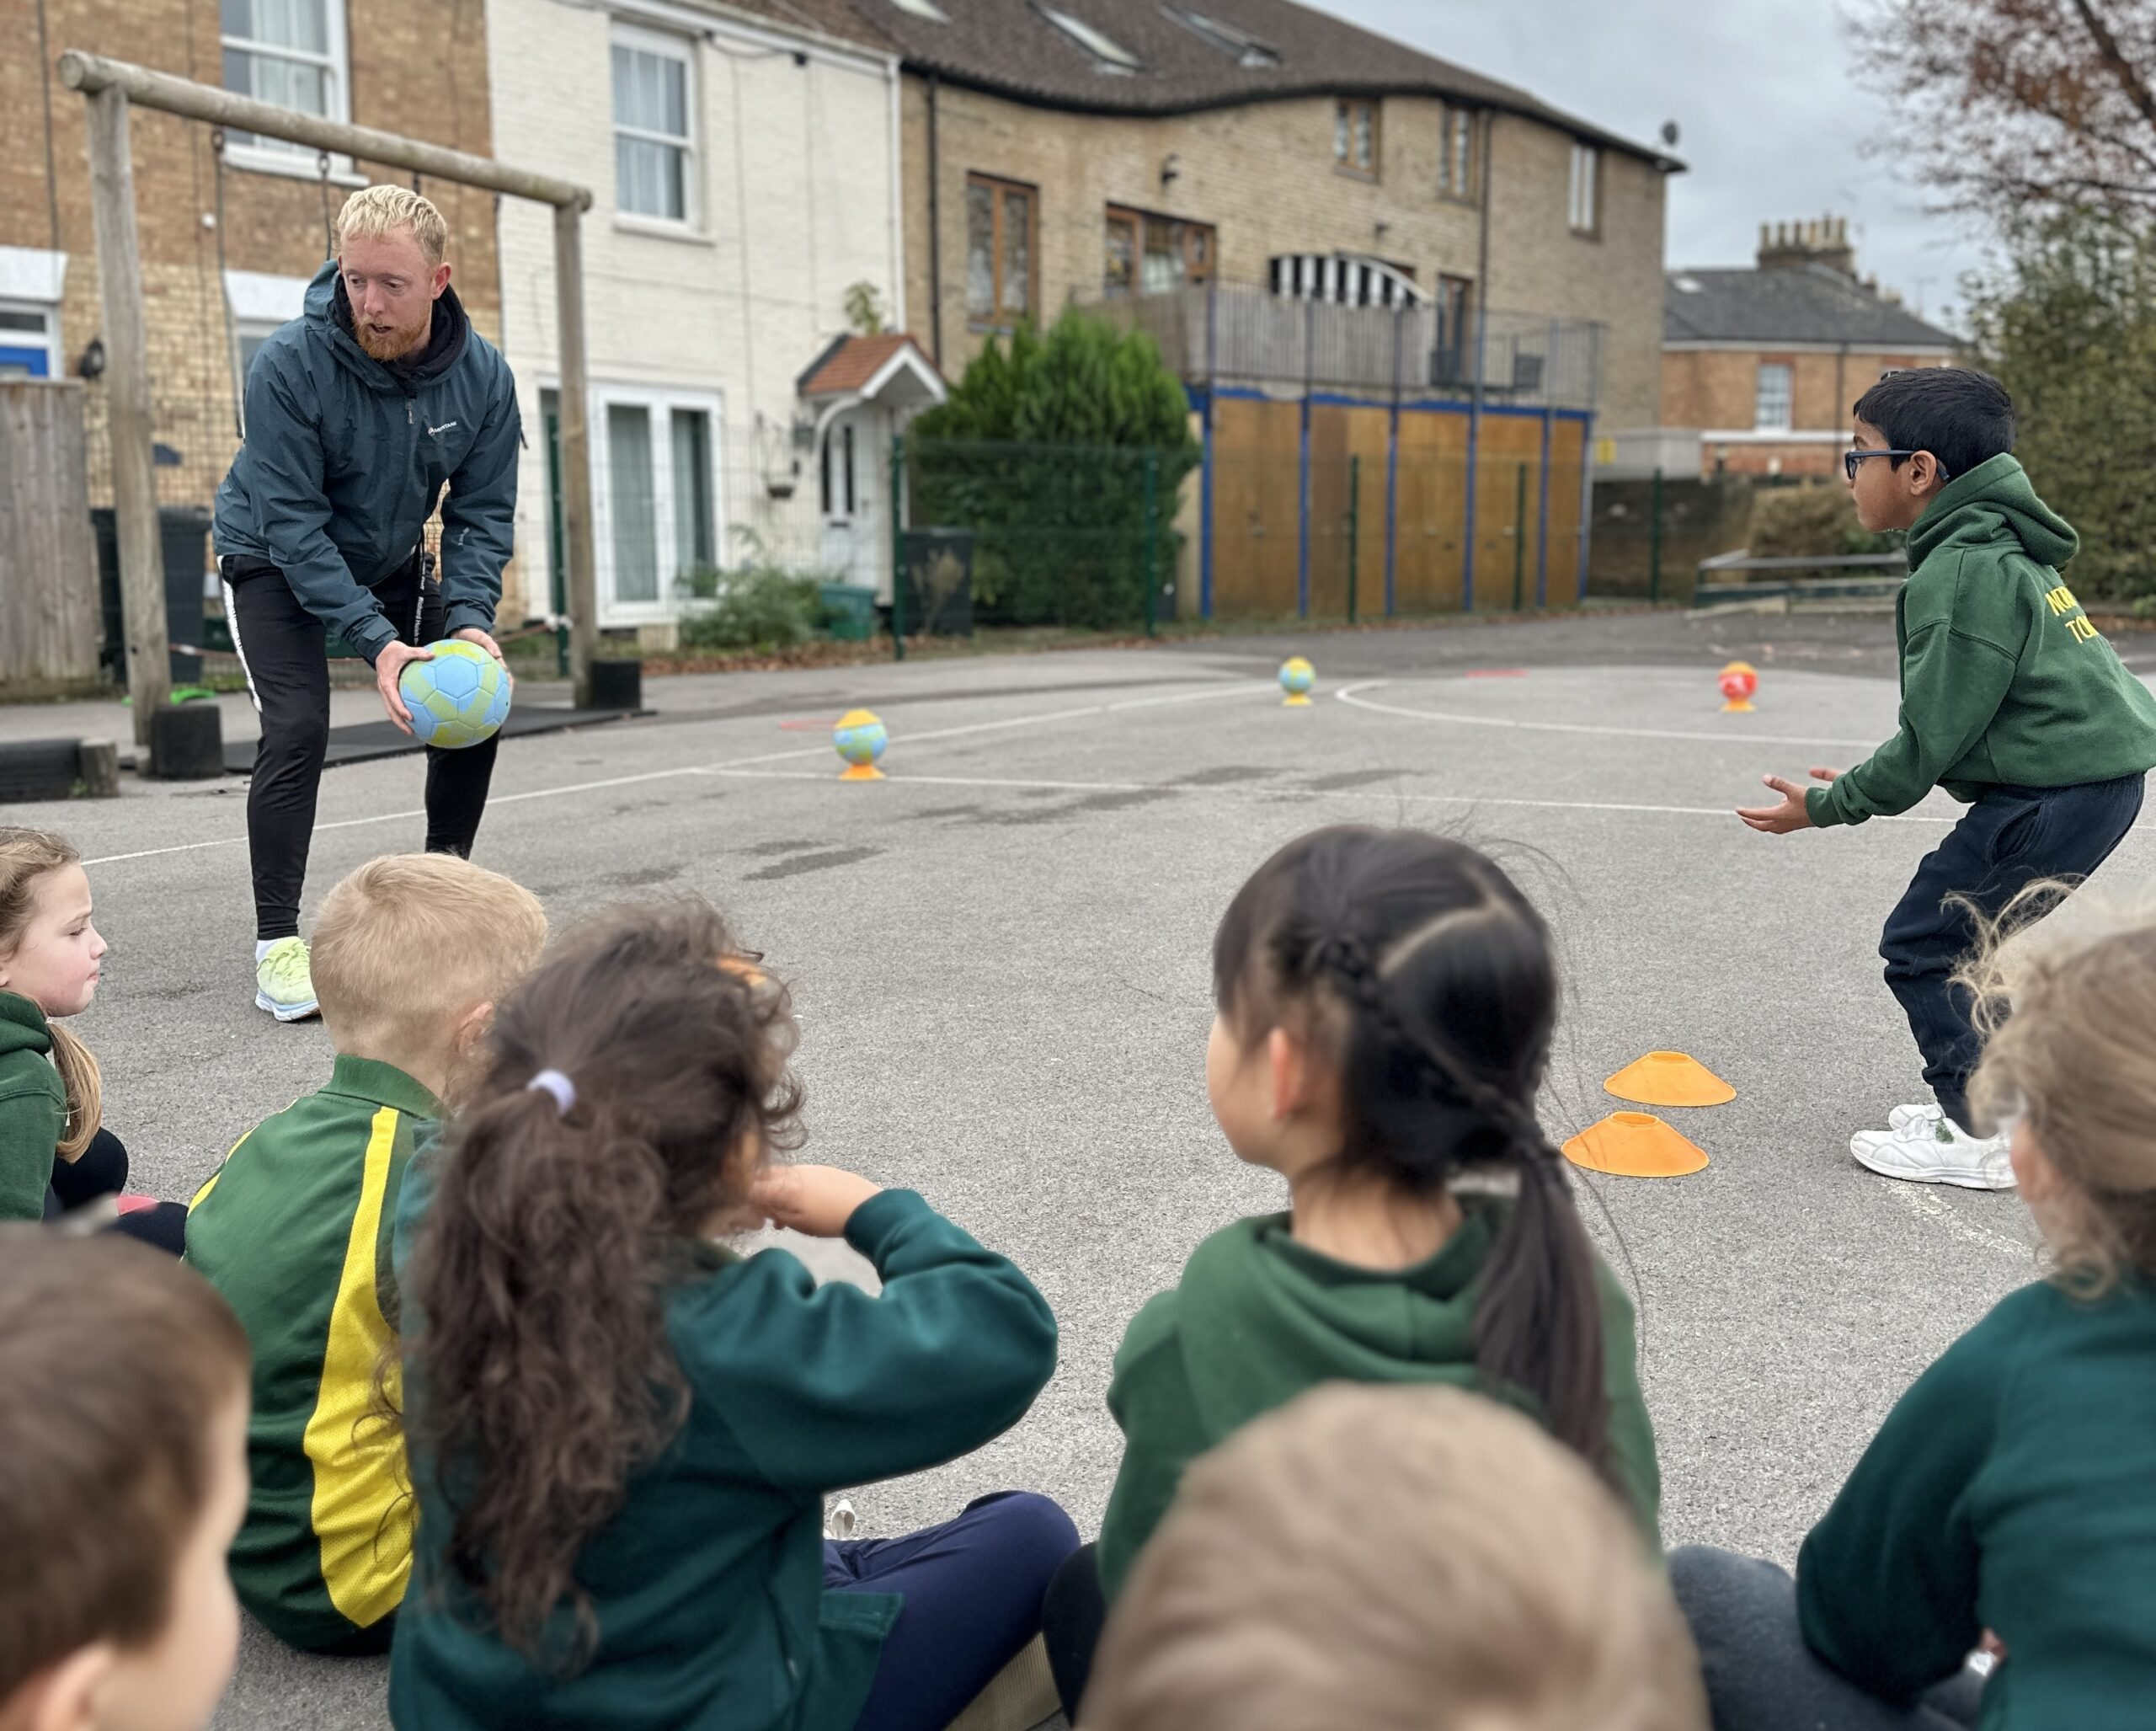
How will my child be included in activities outside of the classroom?
Students with SEND are supported and encouraged to be fully involved in all aspects of school life. Individual arrangements (and risk assessments if necessary) are planned in advance to ensure they can be appropriately included on trips, offsite activities and extra-curricular events.
For those students unable to participate in the usual curriculum’s sporting activities appropriate adaptions have been made to ensure that appropriate challenge and participation is inclusive for all children.

Slide 19

How will my child and I be involved in decision making and planning for their education?
For parents/carers
Parent meetings with class teachers and SENDCO if appropriate
Home visits - reception pupils only as part of transition
Phone calls home
Open door policy
EHCP annual reviews
For children:
Pupil voice surveys
1:1 conversations
Through getting to know your child really well

Slide 20

How will the school support my child’s transition to a new setting?
Prior to starting in Reception, children identified as having SEND will have a School Entry Planning meeting. This will be attended by parent/carers, pre-school staff, school staff and any external professionals involved in supporting your child. An action plan is devised to make the transition to school as smooth as possible. Where it is thought appropriate the North Town staff, will also visit pre-schools to meet the children in a familiar setting. All children will be invited to attend settling-in sessions to ensure they are familiar with the staff and the setting in advance. Home visits are carried out in the Autumn term by our Reception class teachers and teaching assistants.
When moving to Secondary School, children with additional needs are discussed with the SENDCo at the secondary School once places have been allocated. Additional visits can be organised by the secondary school. If your child has complex needs and has an Education Health Care Plan, an Annual Review meeting will take place in the Summer term of Year 5 or the Autumn term of Year 6 to ensure the Local Authority has the information needed to update the child’s Education Health Care Plan and consult with possible secondary schools.

Slide 21

Who should I contact for more information or if I am concerned about my child?
Speak to your child’s teacher in the first instance.
If you are still concerned, you can make an appointment to meet one of the SENDCos (Becca Hampshire – Year 2 to 6, Tracey Burke – Year R and 1 and Christine Tohall - Nursery).
If you feel you need further support, please make an appointment with the Headteacher to discuss your concerns.
If you still have concerns, you may contact our Chair of Governors via the school office.

Slide 22
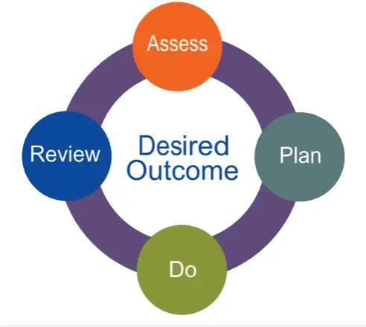
How will the school advise me if they have concerns about my child?
If we have concerns about any aspect of your child’s school life, the most appropriate member of staff will contact you. This may be your child’s class teacher or a member of the school’s Senior Leadership Team.
Staff may also use other opportunities such as your child’s school report, Individual APDR, Pupil Passport or parents evening to let you know about any concerns.
In line with the SEND Code of Practice, we will always inform parents/carers if special educational provision is being put in place for your child and they are being placed on the school’s SEND register.

Slide 23
Who has contributed to this report?
Signed on behalf of the senior leadership team:
Mark Braund (Head teacher)
Becca Hampshire, Tracey Burke and Christine Tohall (SENDCo)
This report was presented to and approved by the school’s Senior Leadership Team in October 2025
Signed on behalf of the Governing Body:
Phil Jones (Chair of the Governing Body) Jessica Smith (SEND Governor)
This report was presented to and approved by the school’s Governing Body

Slide 24
Who has contributed to this report?
A big thank you to the children, parents, carers, external professionals and staff who were consulted on this report during the academic year 2025-26

