Slide 1



This is my family…
My name is…

Slide 2

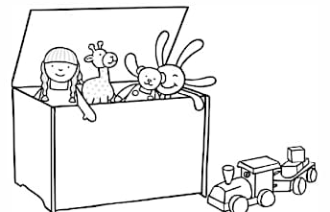

These are other people
who are special to me …
This is my favourite toy…
This is my favourite story…

Slide 3

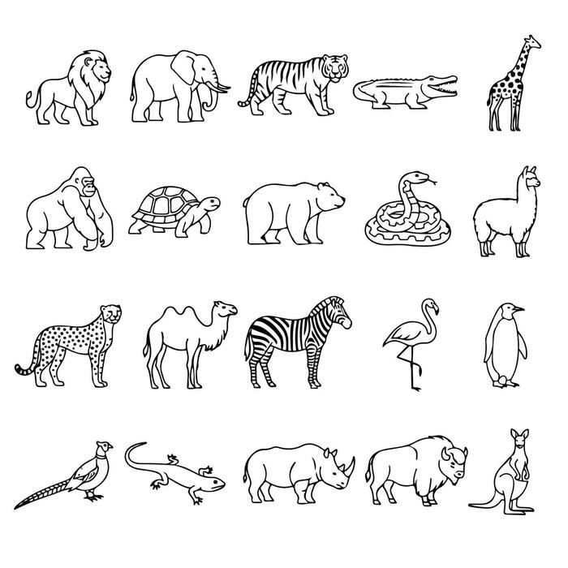


My favourite food is…
This is my favourite animal…
My favourite ice cream flavour is…
This is my favourite place to go…

Slide 4


My favourite things to do are…
This is my favourite colour…
When I am older, I want to be…

