Slide 1
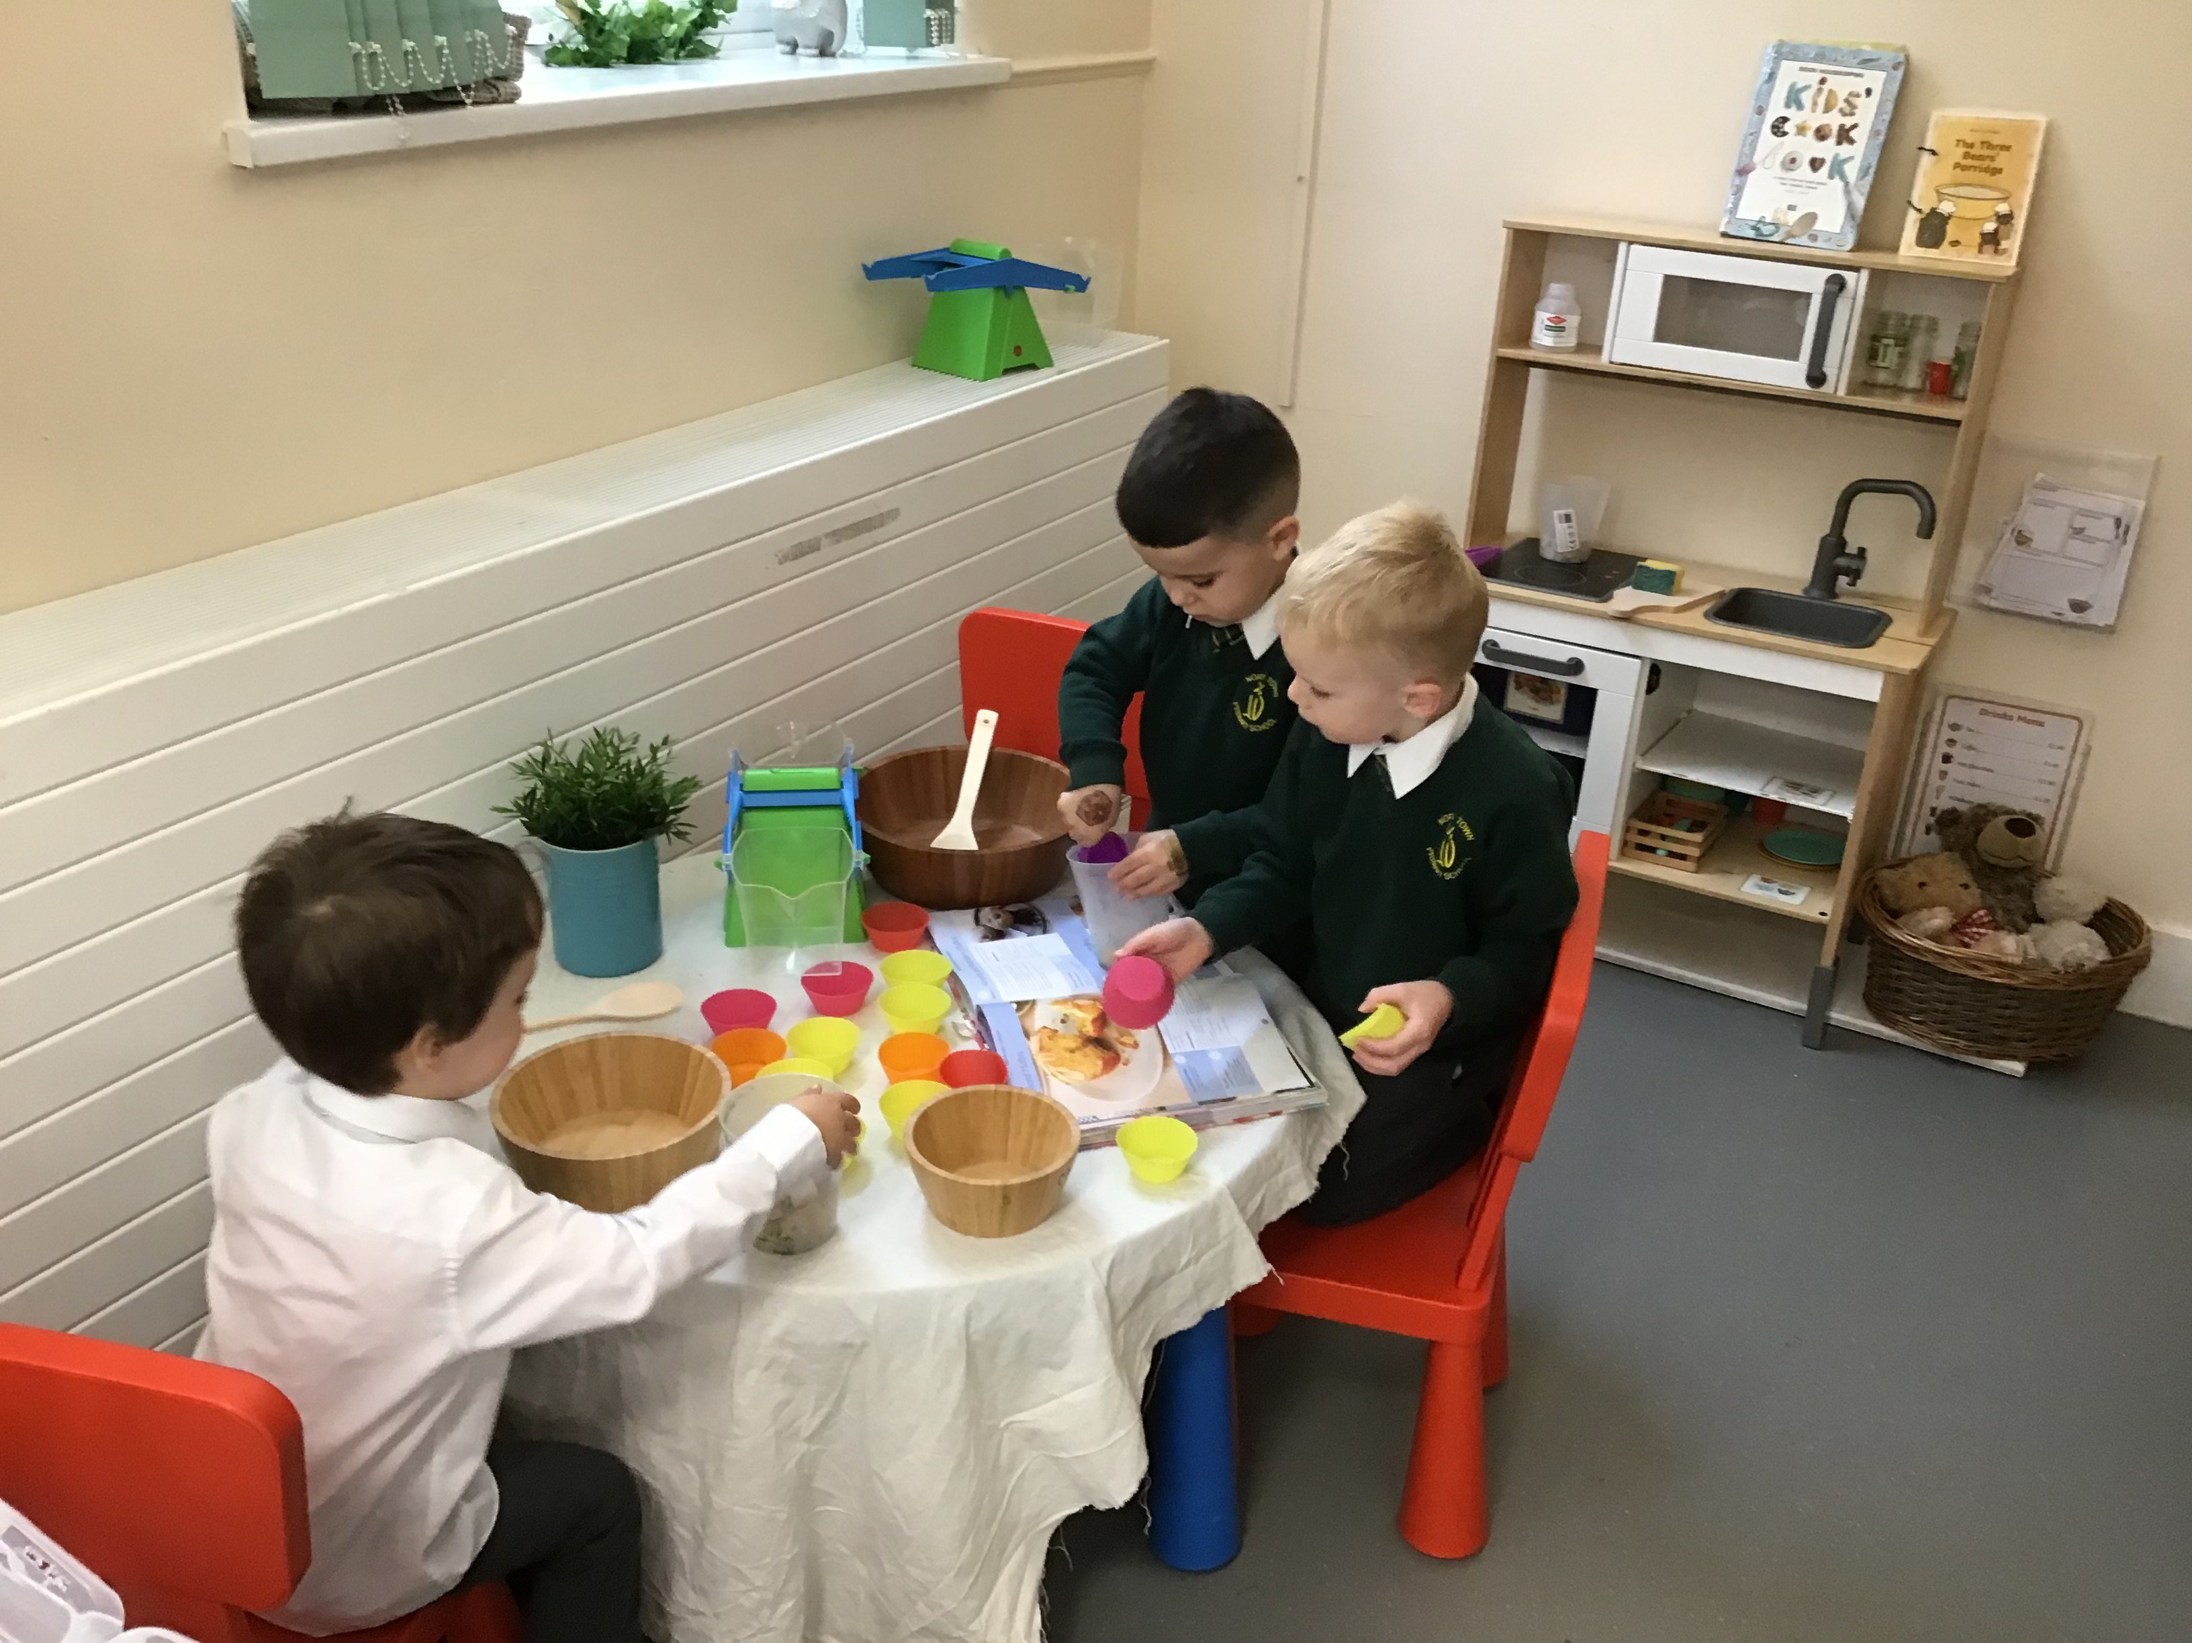

New Parents’ Evening
June 2026
North Town Primary School and Nursery

Slide 2

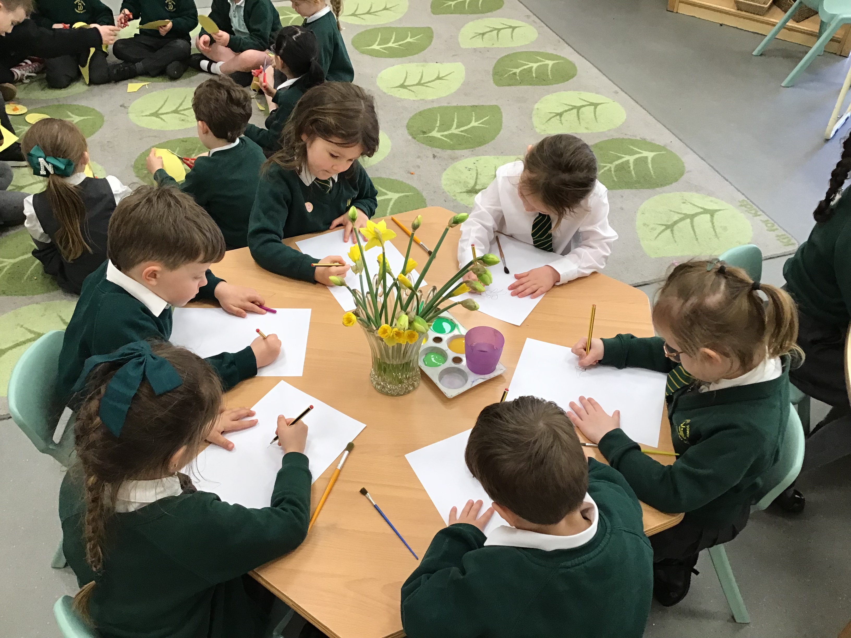
Welcome
Staff Introductions
Head Teacher – Matt Kerton

Slide 3
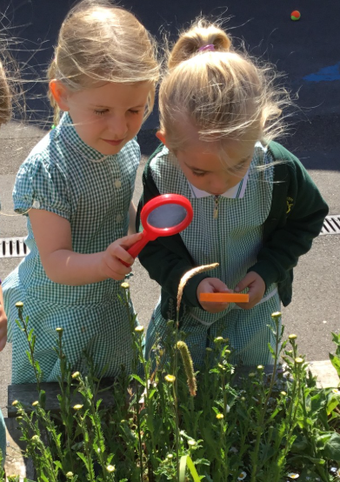
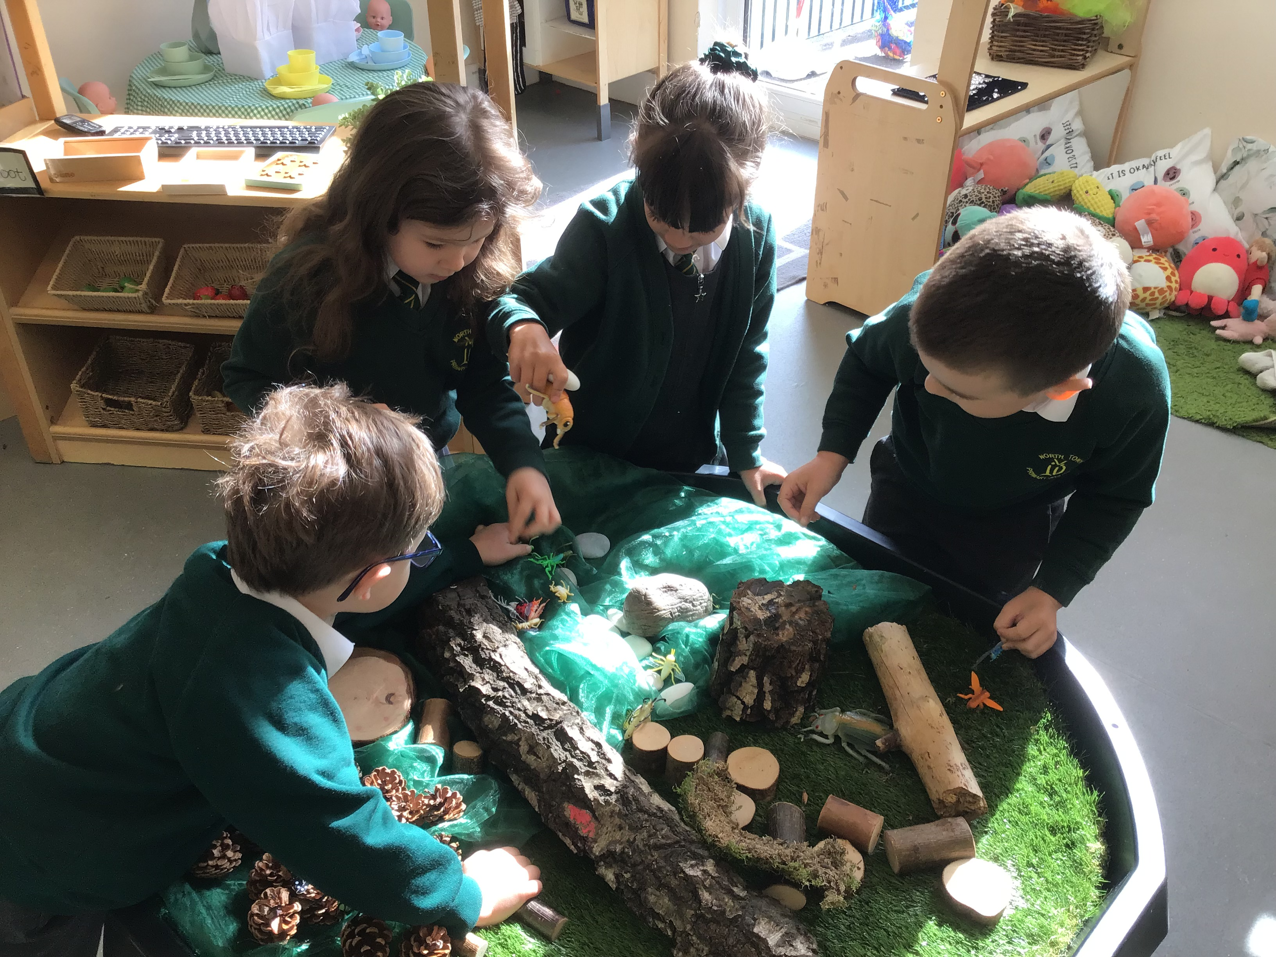
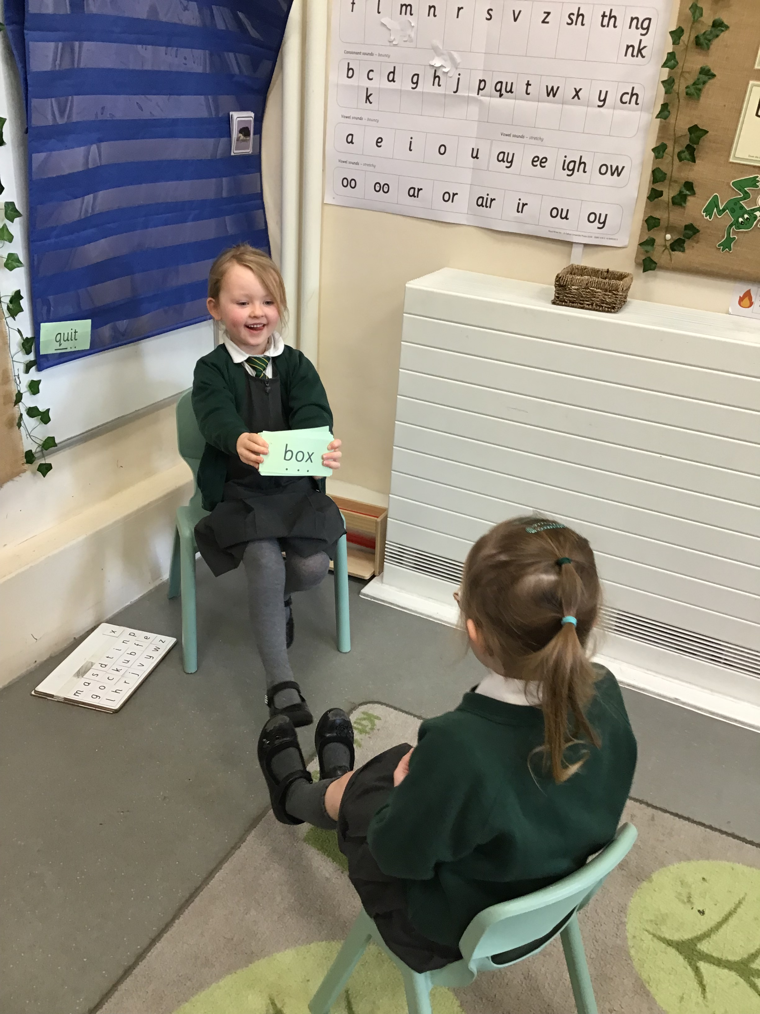
Welcome to Pippins
Early Years Phase Lead – Leann Richards

Slide 4
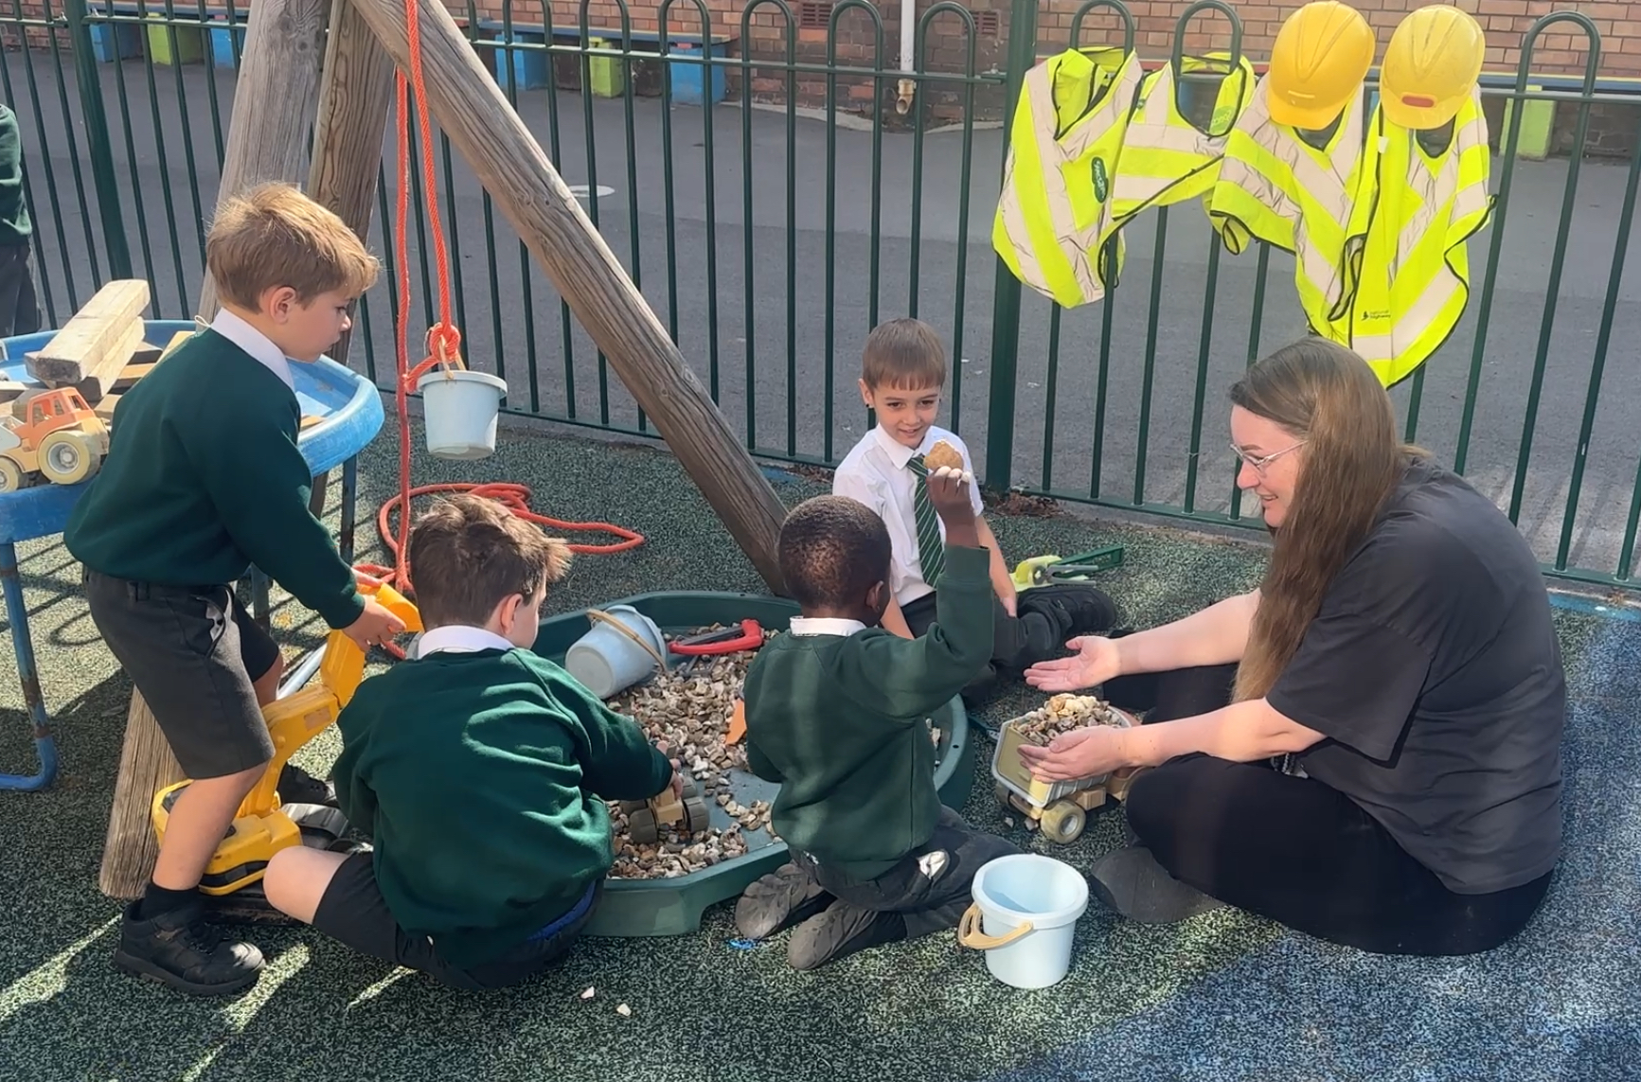
Every child deserves the best possible start in life and the support that enables them to reach their full potential.
At North Town each child is unique and is valued as an individual
We aim to provide a secure foundation to learning with opportunities based on the EYFS and the needs of each individual child.
Communication and Language
Physical Development
Personal, Social and Emotional Development
Communication and Language
Personal, Social and Emotional Development
Physical Development
Literacy
Mathematics
Expressive Arts and Design
Understanding the world
Regular assessment and observations inform us as teachers of
the children’s level of learning and their stage of development.

Slide 5
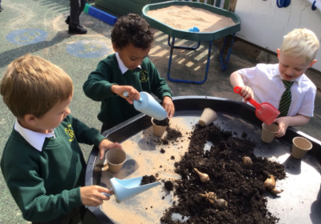
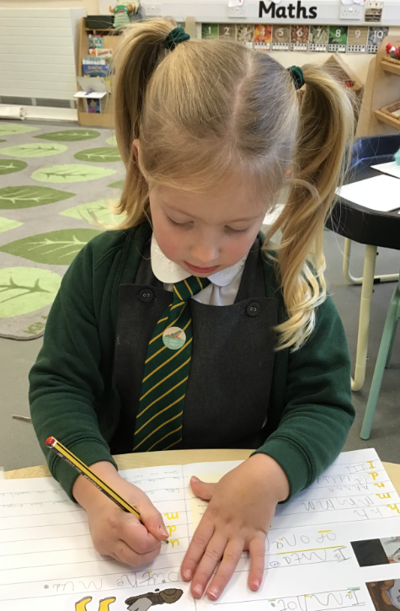
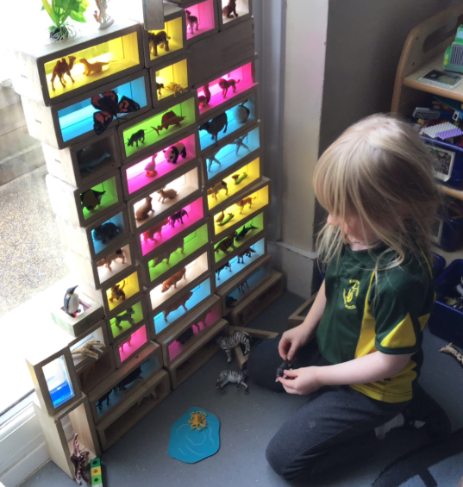
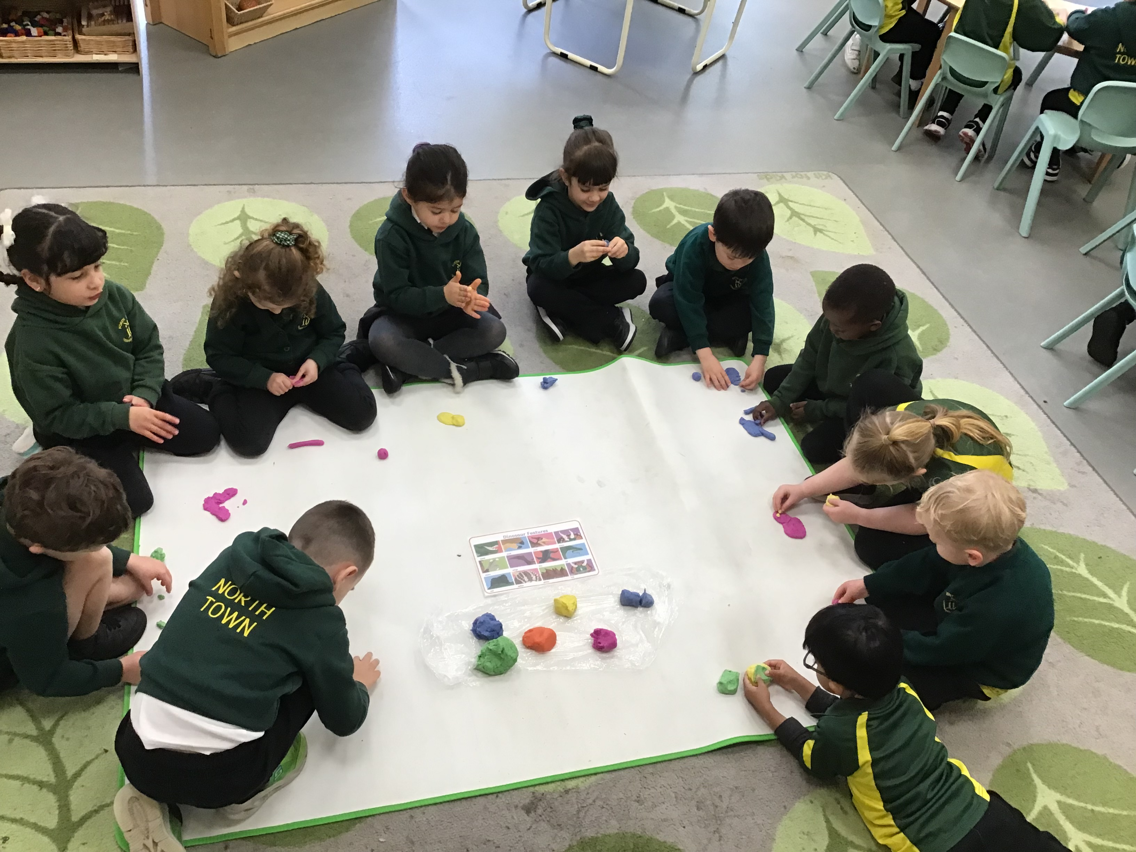
We create a calm, safe and happy environment with engaging and enjoyable learning experiences that enable children to become confident and independent.
Golden Pippins
Outside Area
Middle Area
Toilets
The Orchard
New Rock Pippins

Slide 6
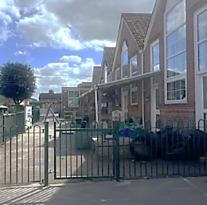
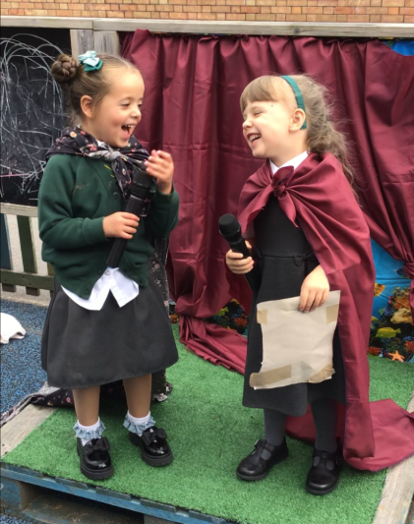
A Typical Day in Pippins
Time | Activity
08:40 – 08:45 | School gates open
08:40 | Pippins staff meet the children at the gate, and they go straight into the classroom
08:40 – 08:50 | Morning Activity
08:50 | Registration / date / visual timetable
09:00 | Book of the Week/Project – followed by Discovery Time and Snack (School Fruit)
10:15 | Snack and Talk Time
10:30 | Phonics - followed by Discovery Time
11:45 | Lunchtime
13.00 | Registration / Thrive time
13.10 | Maths – followed by Discovery Time
14.30 | Snack time (Home snack)
14.45 | Story / rhyme time / Poetry Basket
15:15 | Home time

Slide 7



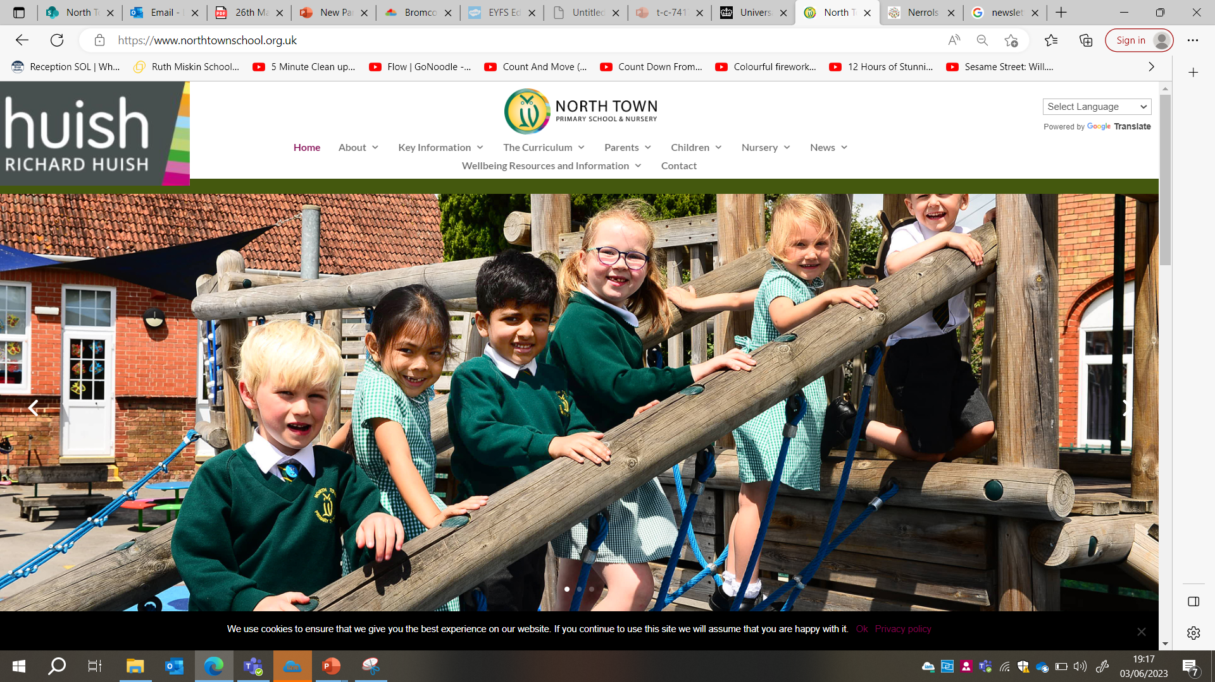

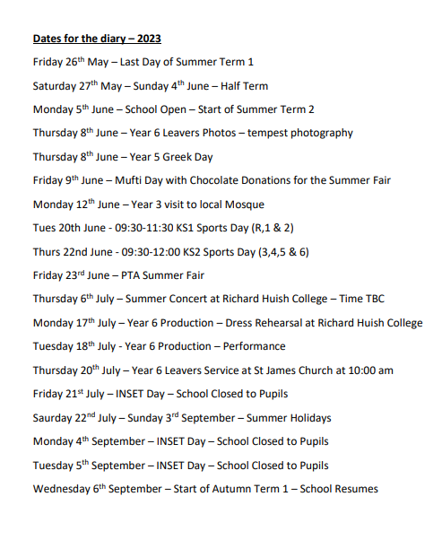

Communication
We strive to create and maintain partnership with parents and carers, encouraging parents to talk to their child’s class teacher about any concerns.
7

Slide 8
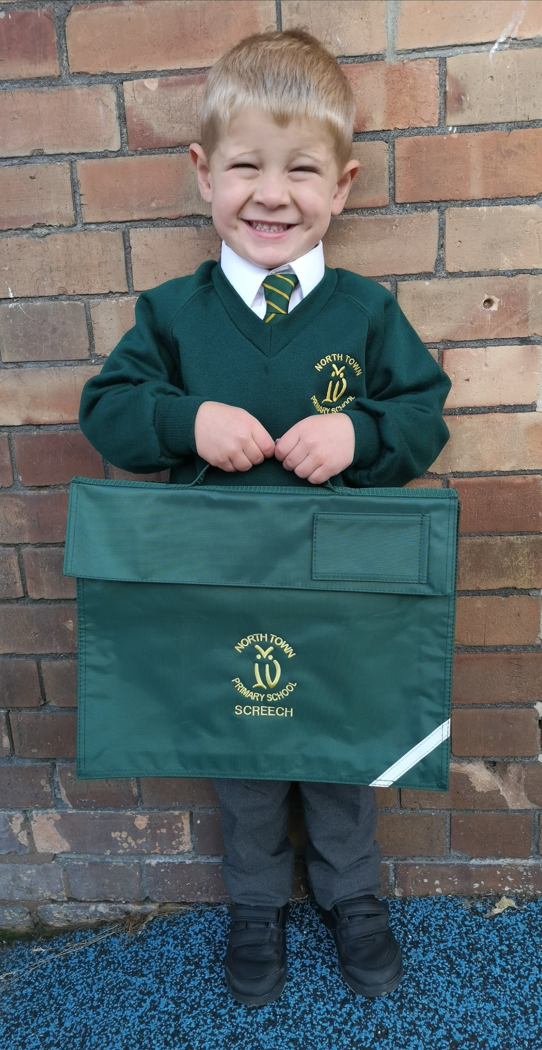
Getting Ready for School
Your child will need the following items:
A named book bag
A named PE kit and named trainers
A named lunch box if having packed lunches
A named water bottle
A named piece of fruit for afternoon snack
Please name each item of the school uniform including shoes
The children do not need back packs

Slide 9

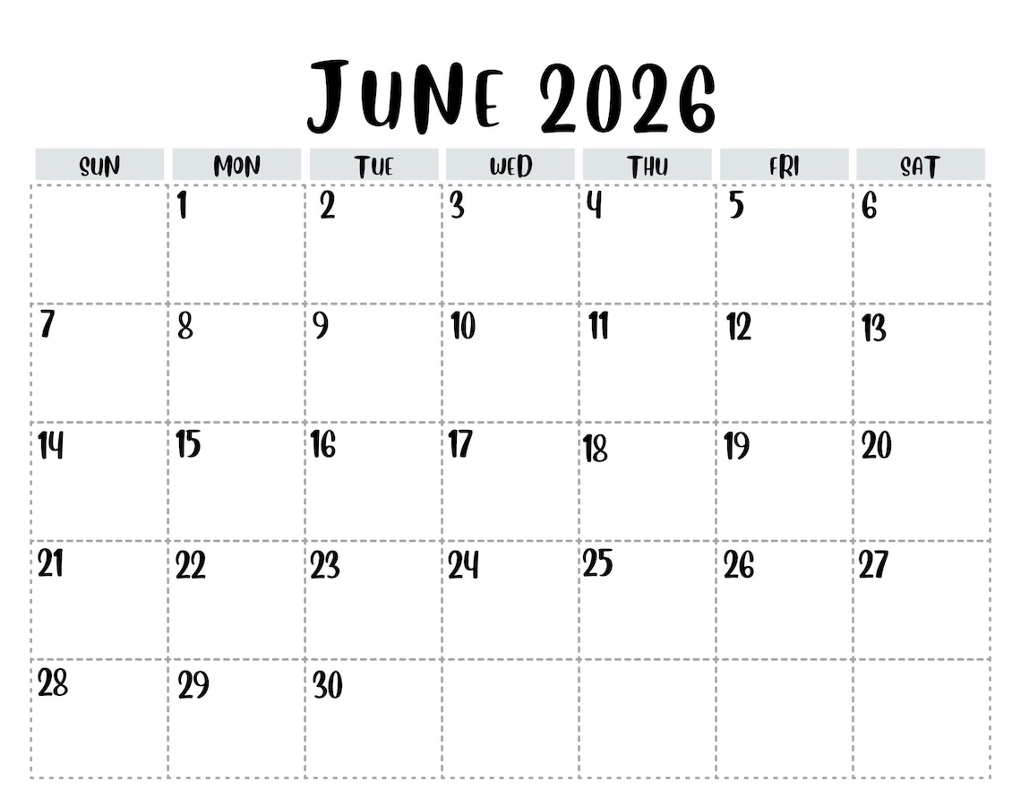
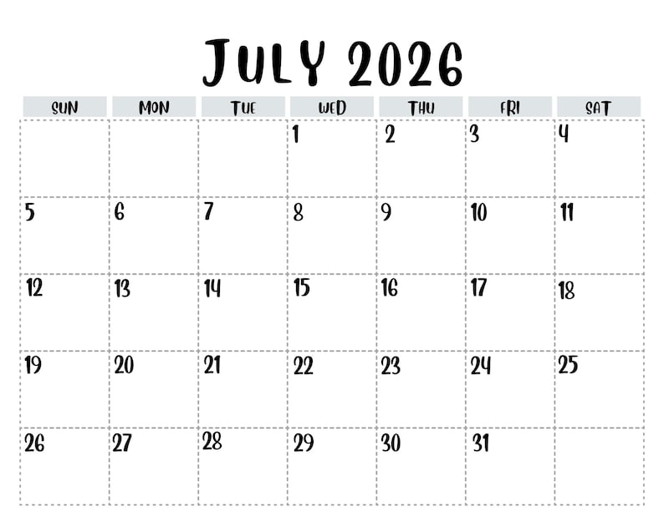
Summer Induction Sessions
Wednesday 17th June
Wednesday 24th June
Wednesday 1st July
This is an additional session for any children who do not attend North Town Nursery. (Group 1)
9:15 – 10:15am
Parents to stay and play in the classrooms
Group 1 – 9:15 – 10:15am
Group 2 – 10:45 – 11:45am
Children to be dropped off at the classroom. Parents stay in the hall for tea and coffee with members of the senior leadership team.
Group 1 – 9:15 – 10:15am
Group 2 – 10:45 - 11:45am
Parents to stay and play in the classrooms

Slide 10
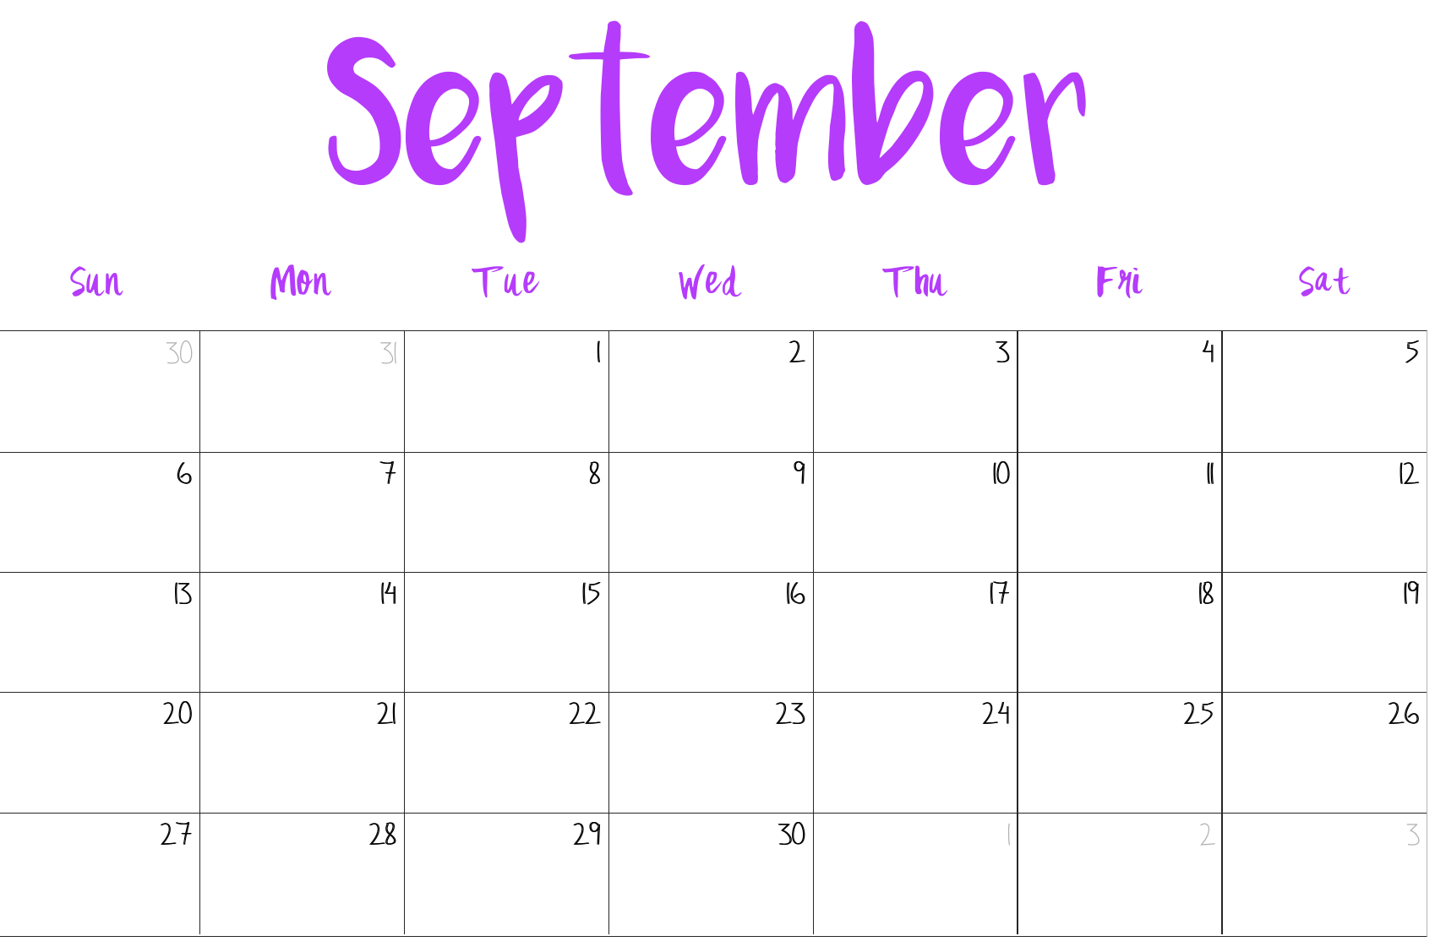
September Induction Sessions
Thursday 3rd, Friday 4th and Monday 7th September 2026
Home Visits - Home visits provide personal 1:1 time for you and your child to get to know the adults
your child will be working with, and an opportunity for you to ask any questions.
Tuesday 8th September
Wednesday 9th September
Thursday 10th September
Group 1 – 9:00 – 10:30am
Group 2 – 1:30 - 3:00pm
Including parents to stay and play.
School Uniform to be worn.
Read, Write Inc information meeting
The children will go home for lunch.
All children - 9.00am - 1.15pm
School Uniform to be worn.
Stay for lunch
All children - 9.00am - 1.15pm
School Uniform to be worn.
Stay for lunch
Your child will be starting school full time on
Friday 11th September 2026
8.40am - 3.15pm

Slide 11
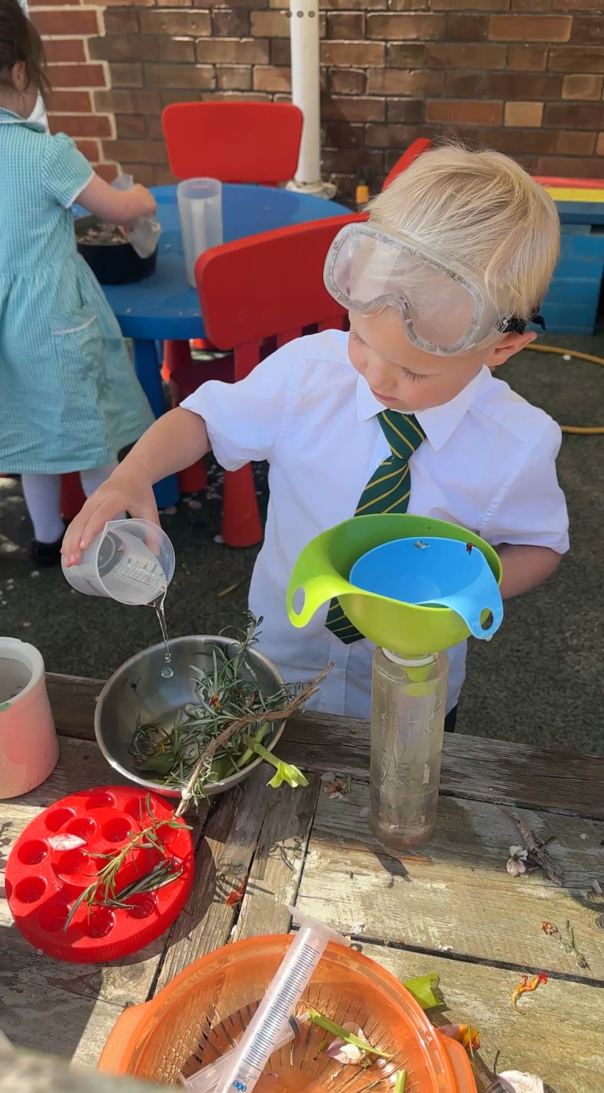
The first full week…
They will explore our Pippins environment.
They will go to lunch every day in the hall.
The children will take part in circle games, parachute games and ‘getting to know you’ games to begin getting to know their peers and to start forming friendships.
They will have a tour of the school in small groups to visit the classrooms and meet all of the staff.
Staff will begin to complete the statutory Baseline Assessments to give us an accurate picture of the children’s learning and areas for development.
They will complete maths activities involving counting, matching and number recognition.
They will begin Read, Write Inc phonics sessions.

Slide 12
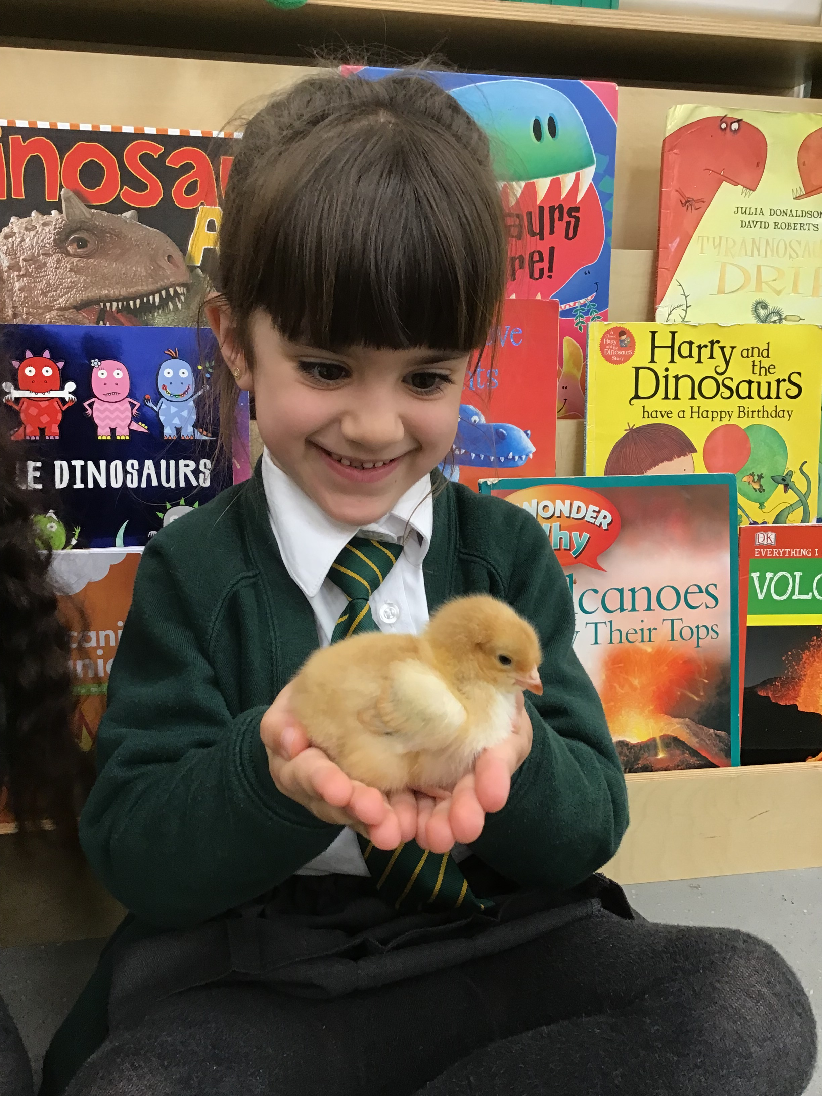
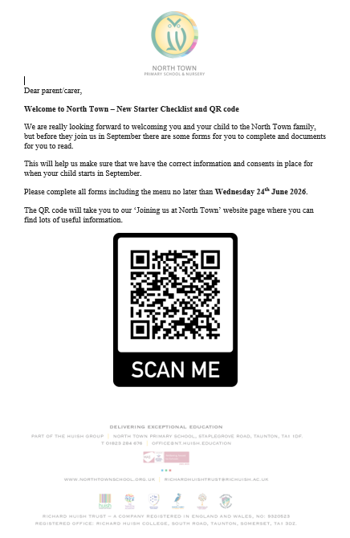
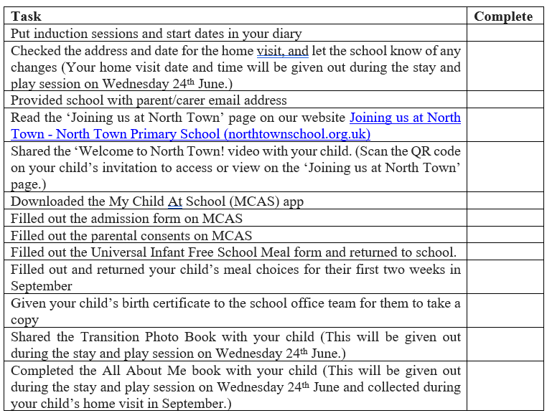
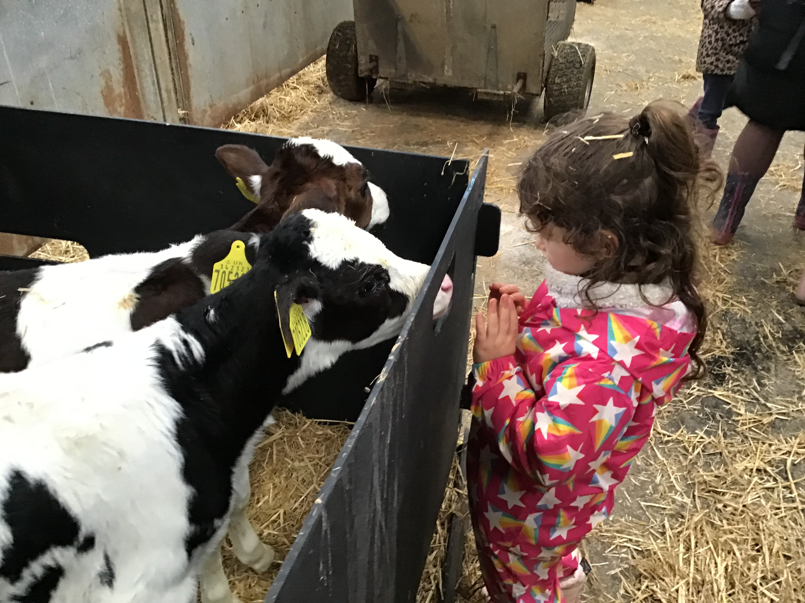
Before September…
Complete ALL forms and return to school by Wednesday 24th June
Share the Transition Book with your child. (This will be given out on Wednesday 24th June)
Complete the ‘All About Me’ book with your child. (This will be given out on Wednesday 24th June)
Purchase school uniform (Second hand uniform available for donations on the 1st July)
Label all items (Uniform, drinks bottle, shoes, snack pots)
Practise independent toileting and hand washing
Share stories, count objects, play games, explore outside and talk!
As you came in you should have been given your New Starter Checklist and QR code letter. This QR code will take you to all of the forms on the website. If you have any problems accessing these forms online, please let us know.

Slide 13
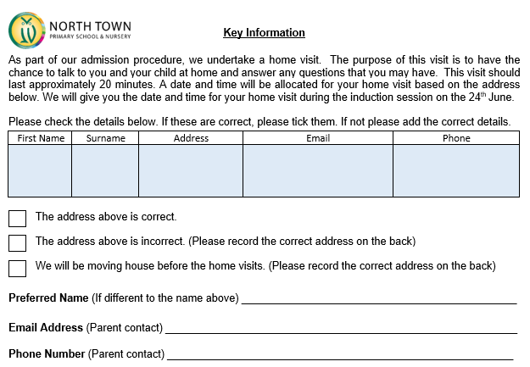
Classroom Activities
Attached to the front of your pack is a ‘Key Information’ slip. Please complete this in the classroom and place it in one of the trays before you leave. This is to ensure we have all of the correct information to help us prepare for home visits, etc. Please check your address, check the spelling of your child’s name and add the preferred name if applicable and add email addresses and phone numbers for parent contacts.
Download the MCAS App.
The office staff will be in touch with your login. If you have any problems logging in the office staff will be happy to help at any of the induction sessions.
Ask any questions
?

Slide 14
THANK YOU
North Town Primary School and Nursery
Thank
you
Tonight’s presentation will be available on our website
www.northtownschool.org.uk

